Slide 1




Engaging SMEs in Documentation Review
Mihai Coanda (Michael), Syncro Soft
mihai_coanda@sync.ro
© 2025 Syncro Soft SRL. All rights reserved.

Slide 2

Agenda
Engaging SMEs in Documentation Review
Importance of documentation in product success
Dangers of inaccurate content
Collaboration with SMEs
Outdated review workflows
Review workflows hurdles
Overcoming the hurdles
  Review tasks
  Real-time collaboration
  Increase SMEs engagement

Slide 3
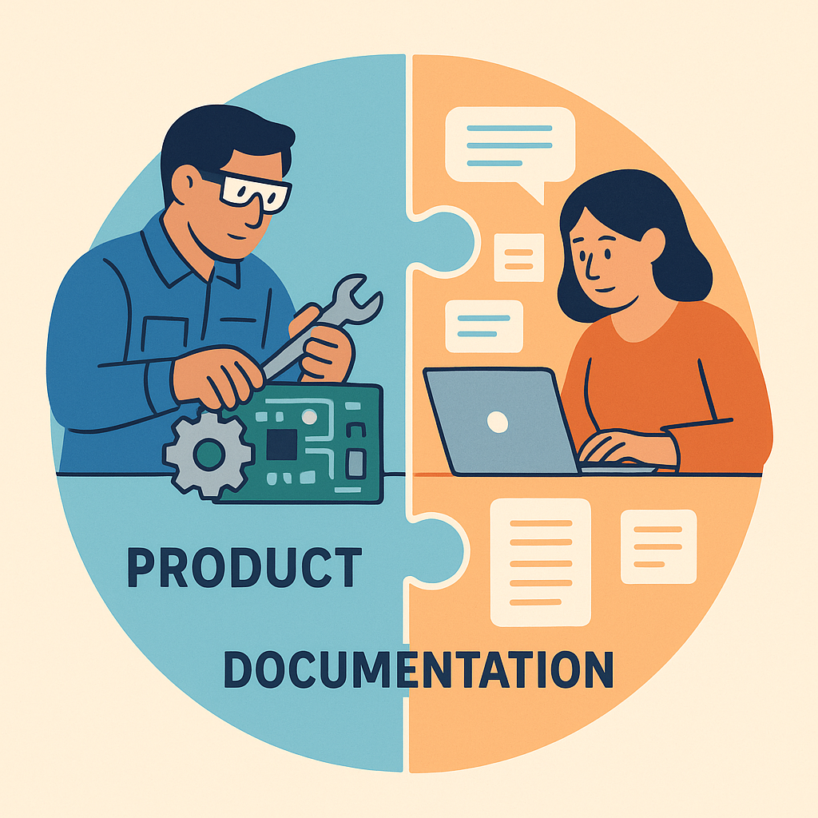
Product + Documentation: The Success Duo
Engaging SMEs in Documentation Review
Capability + Clarity = Value
Discovery & Adoption Booster
24/7 Partner in Support
Boosts Feature Adoption & Retention
Earns Trust & Credibility
Notes:
The product supplies innovative features; documentation shows users how to realise them.
Well-written guides surface hidden gems, turning “nice-to-have” features into everyday wins.
While the product works, docs answer questions instantly—slashing tickets and keeping momentum.
While the product works, docs answer questions instantly—slashing tickets and keeping momentum.
Professional, accurate docs reinforce the product’s quality, easing purchase decisions and renewals.

Slide 4

Risks of Inaccurate Documentation
Engaging SMEs in Documentation Review
Misuse & Safety Hazards
Escalated Support Costs
Eroded Trust
Financial & Legal Exposure

Slide 5

SME + Author = Cornerstone of Accurate Docs
Engaging SMEs in Documentation Review
Blends Deep Expertise with Clear Communication
Enhances User Experience & Brand Trust
Catches Errors Early
Speeds Up Updates
Builds Shared Ownership
Notes:
Slide A – SMEs: Core Strengths
Deep Domain Mastery – intimate knowledge of product architecture, constraints, and edge cases
Real‑World Perspective – firsthand insight into how features are applied in practice
Regulatory & Compliance Awareness – ensures instructions meet safety and legal standards
Authority for Validation – final say on technical correctness and feasibility
Tacit Knowledge Repository – captures tribal know‑how that rarely exists in formal specs
Slide B – Content Authors: Core Strengths
Audience‑Centric Communication – translate complex concepts into clear, actionable language
Information Architecture – organize content logically for quick navigation and reuse (e.g., DITA)
Editorial Consistency – maintain tone, terminology, style, and branding across all docs
Tool & Workflow Expertise – leverage authoring, version control, and publishing systems efficiently
Process Orchestration – coordinate reviews, deadlines, and multi‑format delivery with minimal friction

Slide 6
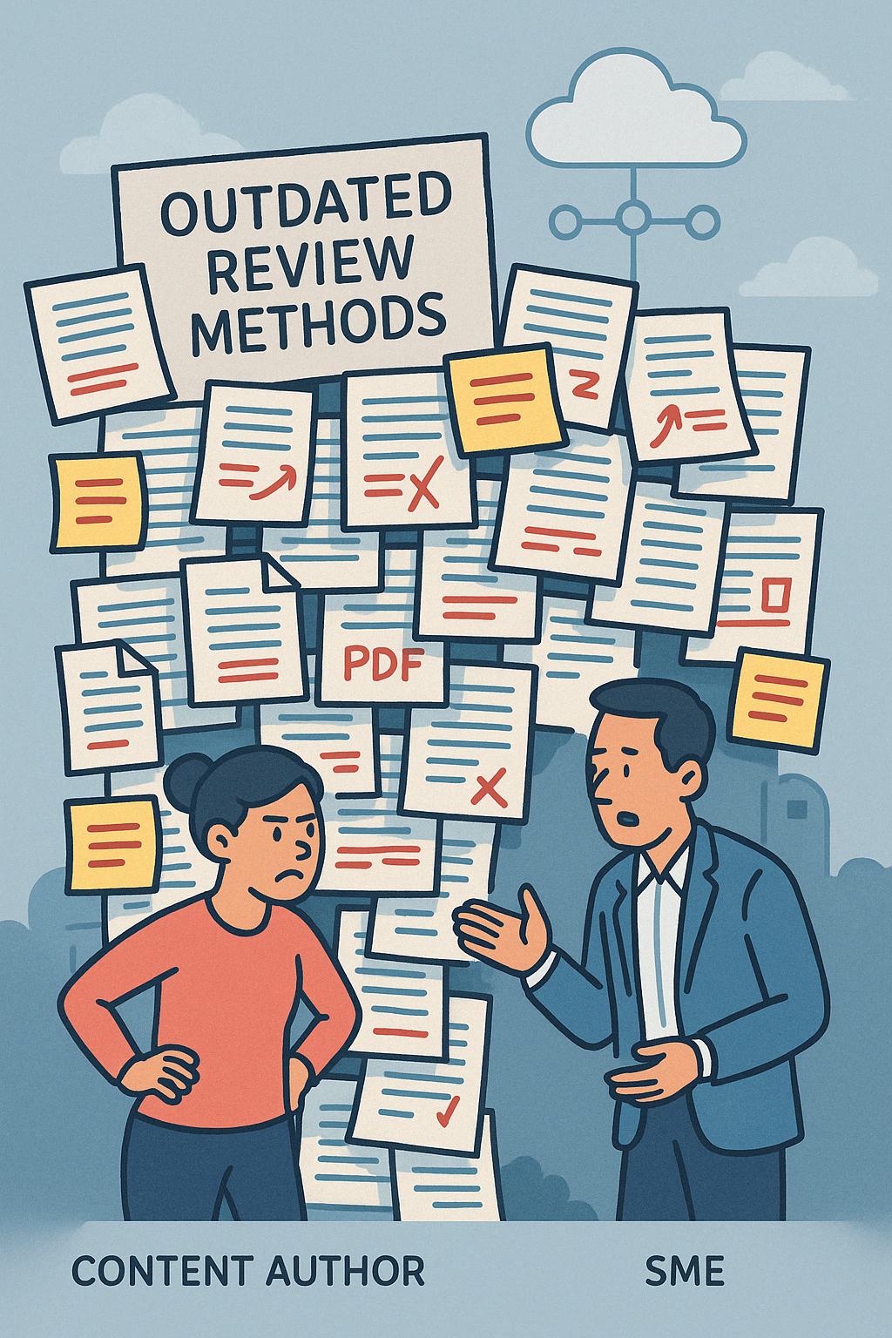
Outdated Review Methods
Engaging SMEs in Documentation Review
Word Docs with Track Changes
PDF Annotations
Email Threads & Attachments
Shared Network Folders
Bug Tracker Tickets (e.g.,Jira)
Printed Hard‑Copy Mark‑ups / Face-to-Face Reviews
Notes:
time-consuming to transcribe, prone to data loss
heavy files, conflicting edits, manual copy-paste into DITA/XML
comments easily missed or duplicated across separate files
feedback scattered
hard to version-control
unclear “latest” file
SMEs overwrite each other’s notes
fragmentary remarks
difficult to trace back to specific content blocks

Slide 7
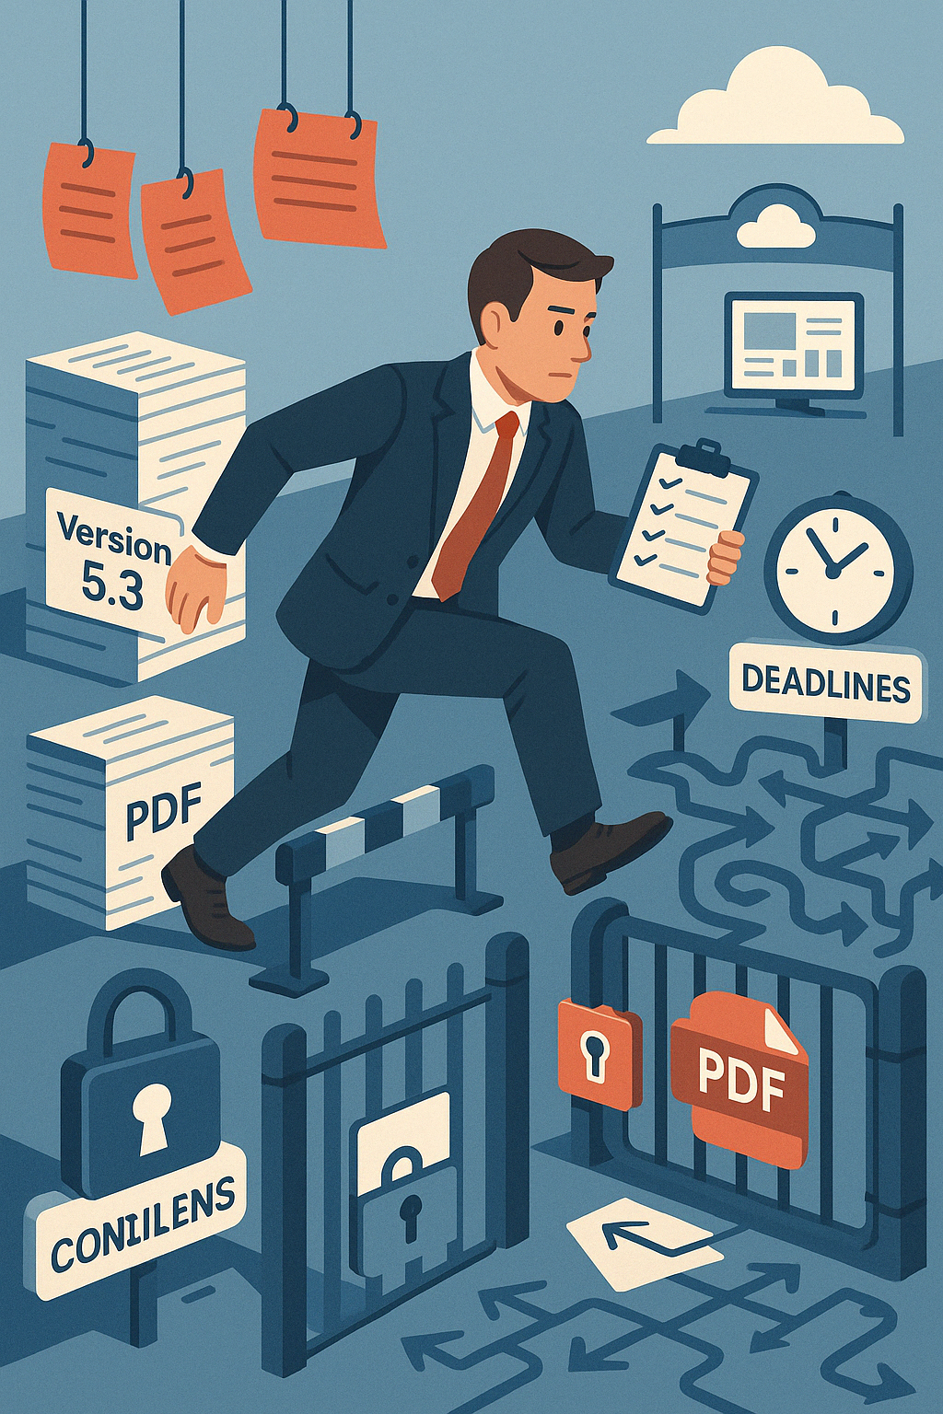
Biggest SME‑Doc Review Hurdle? Poll
Engaging SMEs in Documentation Review
Cumbersome Tools / Process
Access & Permission Hurdles
Limited Time
Low Documentation Priority
Other - please specify in the Questions view
Notes:
SMEs are often busy with primary roles.

Slide 8
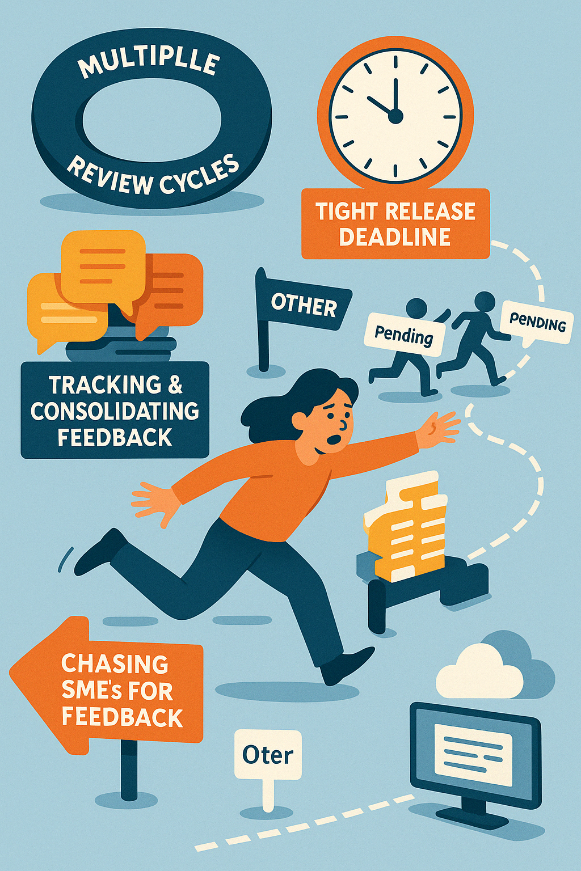
Biggest Hurdle for Content Authors - Poll
Engaging SMEs in Documentation Review
Tracking & Consolidating Feedback
Chasing SMEs for Feedback
Multiple Review Cycles
Meeting Tight Release Deadlines
Other - please specify in the Questions view

Slide 9
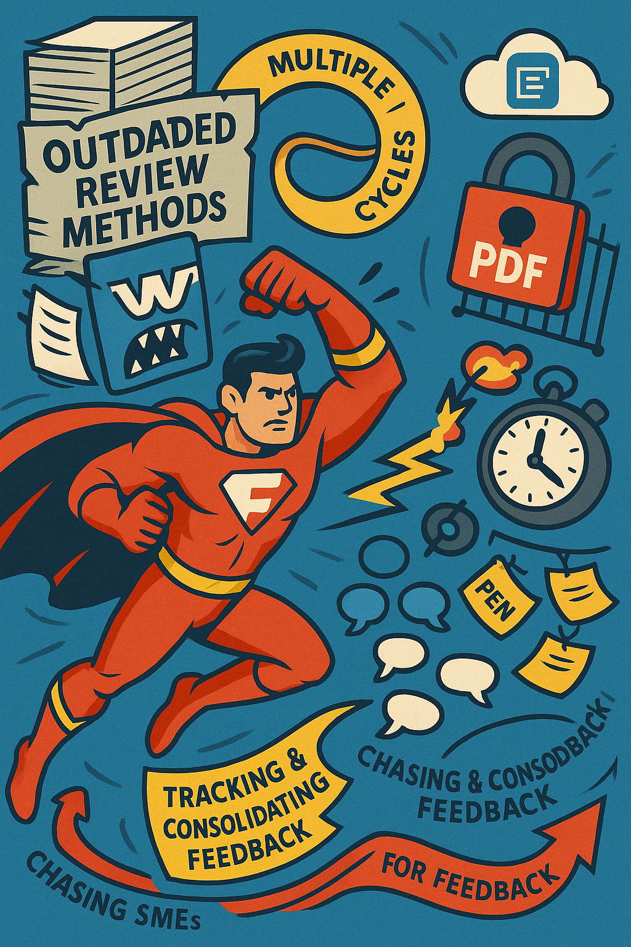
c
Engaging SMEs in Documentation Review
Single document format
Full access-control
Real-time Collaboration
Evolution tracking
Flexible workflow

Slide 10
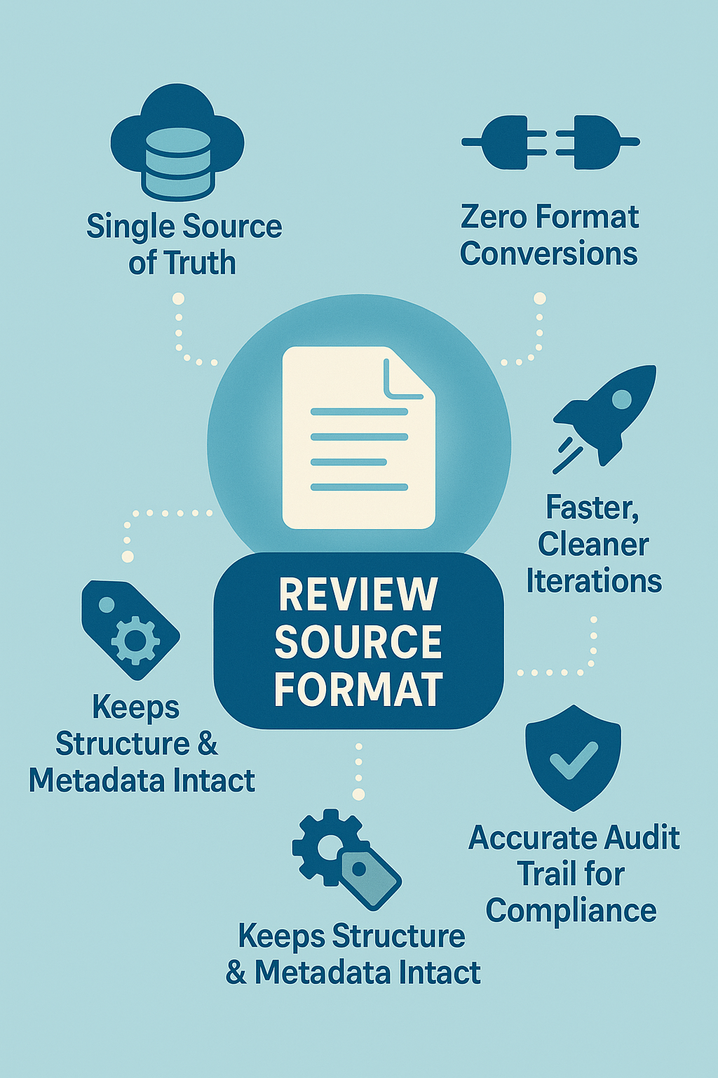
Review Source format
Engaging SMEs in Documentation Review
Single Source of Truth
Zero Format Conversions
Faster, Cleaner Iterations
Accurate Audit Trail for Compliance
Keeps Structure & Metadata Intact
Better context
Notes:
No more Manual Re‑integration into DITA/XML – copying edits from Word/PDF back into source

Slide 11
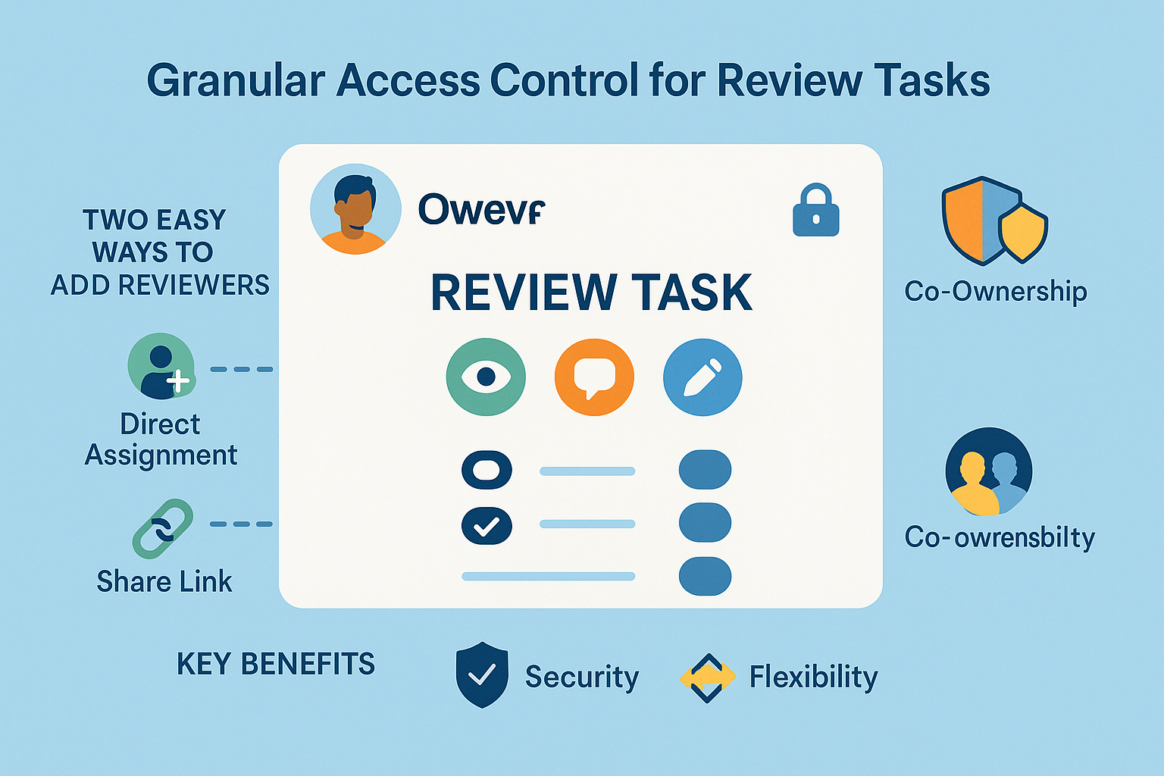
Granular Access Control for Review Tasks
Engaging SMEs in Documentation Review
Owner-Controlled Sharing
  Direct Assignment
  Share Link
Optional Co-Ownership
Key Benefits
  Security
  Confidentiality
  Flexibility
  Accountability

Slide 12
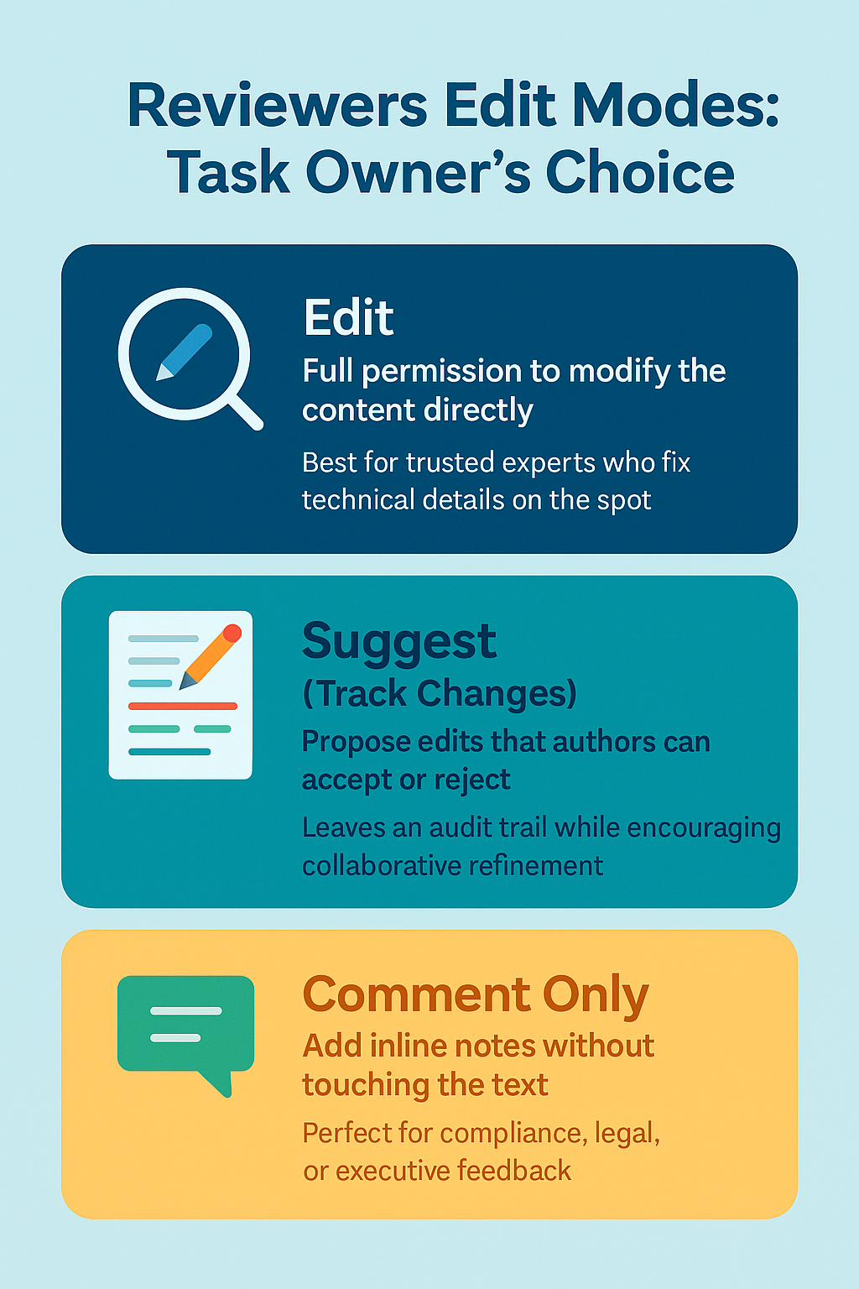
Reviewers Edit Modes: Task Owner’s Choice
Engaging SMEs in Documentation Review
Edit
  Full permission to modify the content directly
  Best for trusted experts who fix technical details on the spot
Suggest (Track Changes)
  Propose edits that authors can accept or reject
  Leaves an audit trail while encouraging collaborative refinement
Comment Only
  Add inline notes without touching the text
  Perfect for compliance, legal, or executive feedback
Notes:
Why it matters
• Balances speed with control and document integrity
• Matches the right level of access to each reviewer’s role

Slide 13

Real-time Collaboration
Engaging SMEs in Documentation Review
Real-Time Co-Editing
Instant Conflict Resolution
Zero Duplicate Feedback
Faster Review Cycles
Transparent Ownership & Engagement
Context-Rich Discussion Threads
Notes:
Multiple SMEs and the author work in the same DITA topic simultaneously—no waiting for “their turn.”
Live visibility of each other’s edits lets the team align terminology, facts, and style on the spot.
One shared source means no parallel Word/PDF files or redundant comments to reconcile.
A single collaborative session replaces several asynchronous rounds, shaving days off release timelines.
Presence indicators and change history highlight each contributor’s impact, fostering accountability.
Inline comments and @mentions keep questions anchored to exact content blocks, ensuring clarity.
Following the feedback from multiple SMEs
* keeping draft, reviewed, and final files in sync
* no clear view of who has reviewed what and when
* merging contradictory SME inputs
Tools like Oxygen XML Content Fusion enable this concurrent editing model, uniting SMEs and authors in one efficient workspace.

Slide 14

SMEs Review Experience
Engaging SMEs in Documentation Review
Clean, Familiar UI
Friction-Free Entry
Designed for Speed
Real-Time Collaboration
Engagement by Convenience
Notes:
Looks and feels like Word Online or Google Docs, so SMEs can start editing with zero learning curve.
Open the shared link in any browser—no installs, no XML know-how required.
Live cursors and comment threads show every change instantly, avoiding duplicate effort (e.g., one typo fix is visible to all).
A smooth, quick workflow respects SMEs’ tight schedules—making them far more willing to review again in the future.
!!!! DRAFT INITIATION !!!!

Slide 15
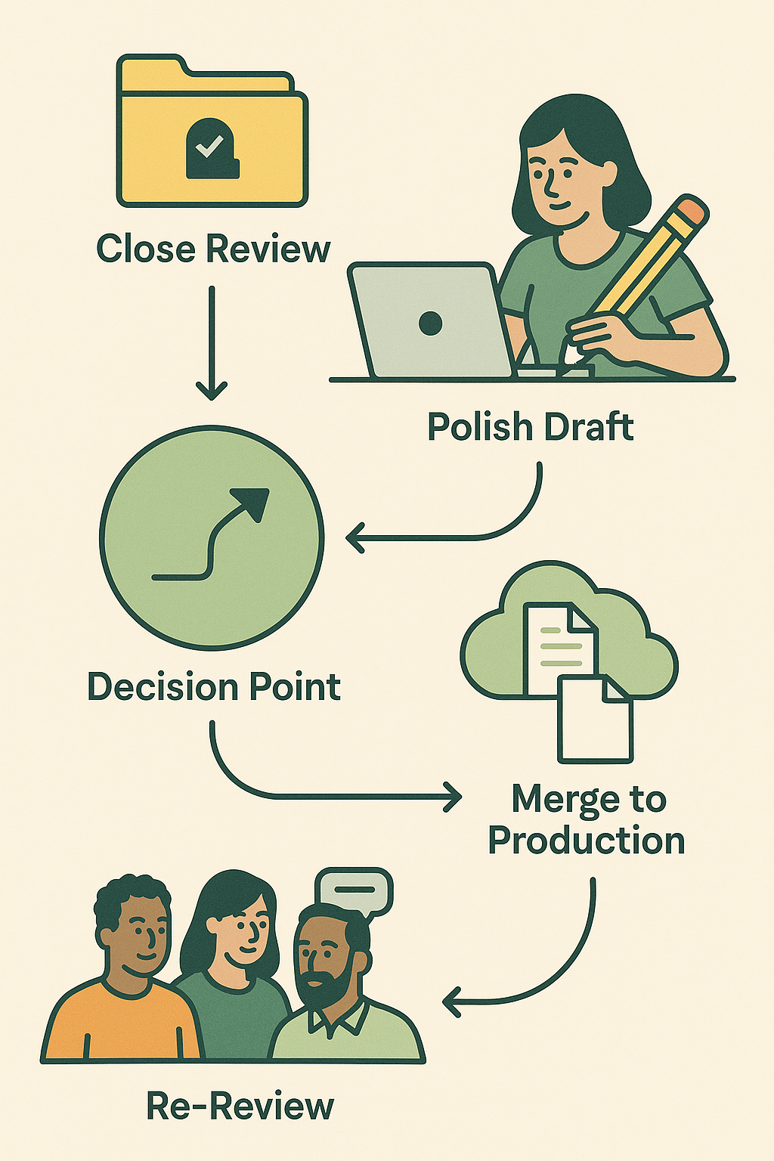
Author Workflow: From Feedback to Production
Engaging SMEs in Documentation Review
Close the Review
Polish the Content
Decision Point
  Request Re-Review
  Merge to Production
Notes:
Close the Review
• Once all SMEs click Finalize Review, the author marks the task Closed for polishing.
• Reviewers switch to read-only; only the task owner can edit.
Prevents late, uncontrolled edits while polishing.
Polish the Draft
• Consolidate comments, resolve conflicts, apply style guides, and run validation checks.
SEARCH In review
• Ensures the content is clean, consistent, and build-ready.
• Provides a clear, auditable path from SME feedback to production-ready content.
3 ) Decision Point
• Request Re-Review – if refinements need SME eyes again,
reopen with one click;
all reviewers are auto-notified.
• Merge to Production – if satisfied, integrate the polished XML/DITA topics back into the main documentation project (CI/CD, translation, publish).

Slide 16
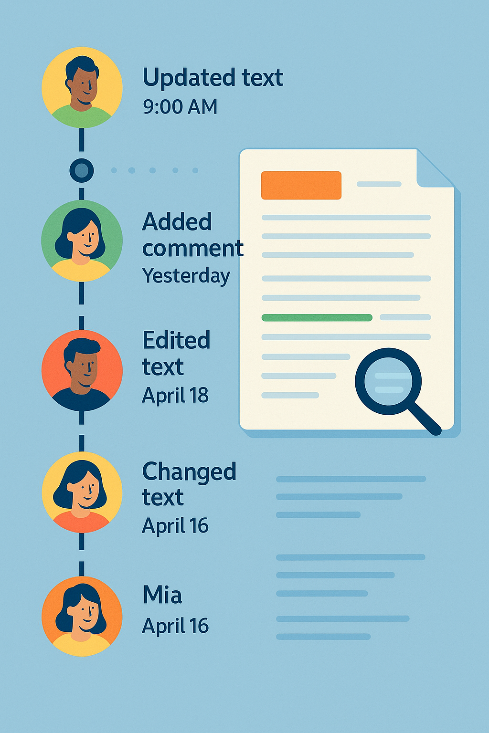
Evolution Tracking & Accountability
Engaging SMEs in Documentation Review
Full Version Timeline
Built-In Diff Viewer
Who-Changed-What-When
Accurate Audit Trail for Compliance
Changes notifications
Notes:
Automatic snapshots capture each save, letting reviewers scroll back to any point in the review.
Side-by-side display highlights every addition, deletion, and move in real time.

Slide 17
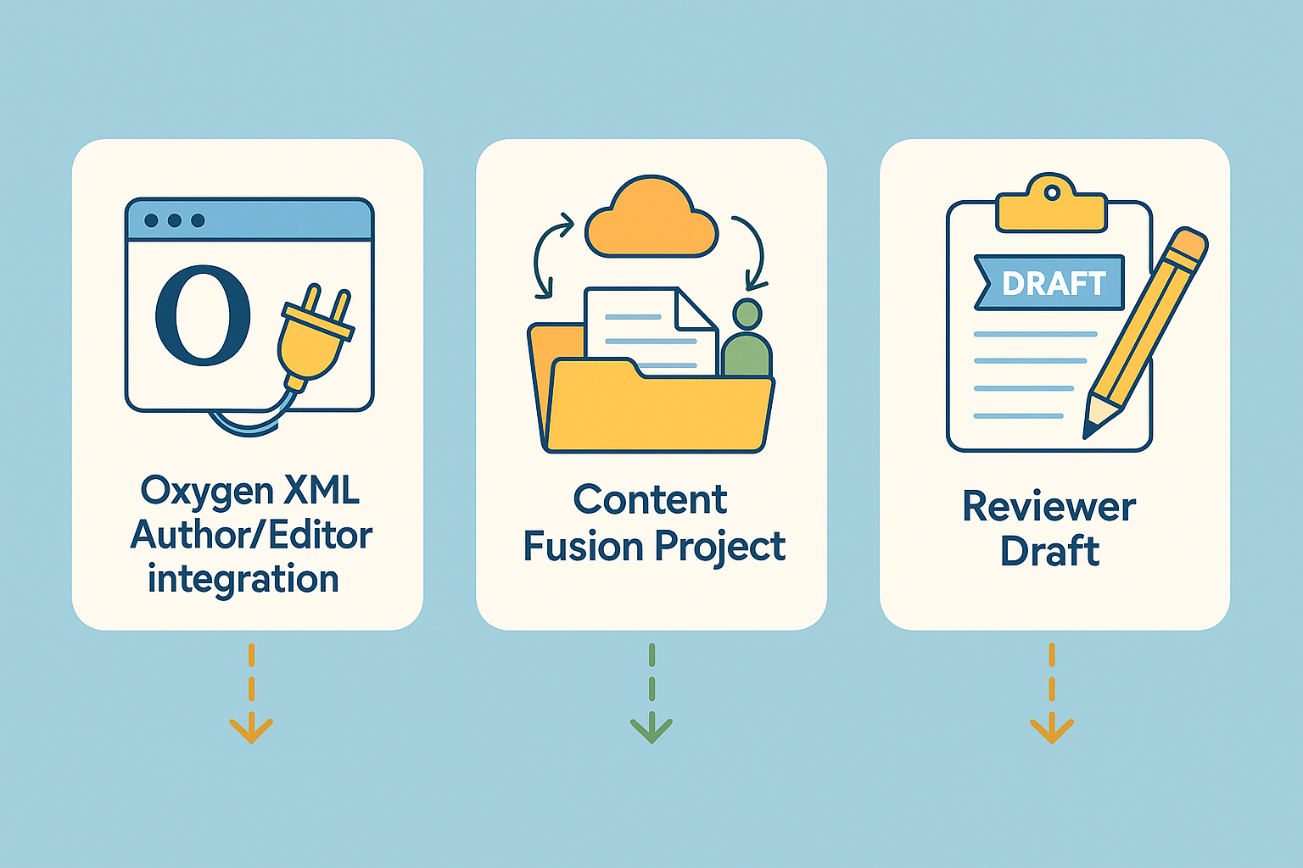
Merge to Production
Engaging SMEs in Documentation Review
Review task types
  Oxygen XML Author/Editor integration
  Content Fusion Project
    Project Content
    Personal workspace
  SME initiated draft

Slide 18

Engaging SMEs in Documentation Review

Slide 19

Engaging SMEs in Documentation Review

Slide 20

THANK YOU!
Any questions?
Mihai Coanda
mihai_coanda@sync.ro
© 2025 Syncro Soft SRL. All rights reserved.

